Slide 1


Beer review
Predicting beer review overall from customers
Author: Julián Horvath
7/14/2022

Slide 2

Data Facts
3197 beer reviews
934 breweries
Features describing an overall profile: Name – Style – ABV – Min/Max IBU
Features picturing specific profiles: Body – Malty – Fruits – Hoppy…
Review features: Review Overall – Review Taste/Palate/Aroma/Appearance
Sources
Kaggle: https://www.kaggle.com/datasets/ruthgn/beer-profile-and-ratings-data-set
BeerAdvocate: https://www.beeradvocate.com/community/threads/how-to-review-a-beer.241156/

Slide 3

Business Framework
WHAT
Beer review overall prediction from customers
WHY
We suspect beer features have some type of relation with their review overall score
GOAL
Looking for improvements on production, sales and consumption decisions.

Slide 4

Methodology
Data was filtered by beers with at least 25 reviews. That was the criteria to build descriptive features
Feature selection based on hypothesis testing during model training
POC with and without data scalement
Feature Engineering, grouping features by business criteria

Slide 5

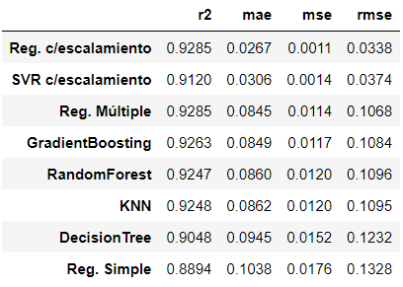
Results
Multiple Lineal Regression had the best performance in capturing review overall variability
Data scalement substantially minimizes error predictions for all models
Picking out Mean Squared Error (MSE) as primary error metric to compare models results, we penalized deviations specifically on major variability zone identified under 3 score.

Slide 6
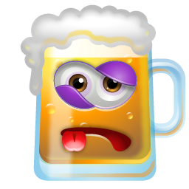
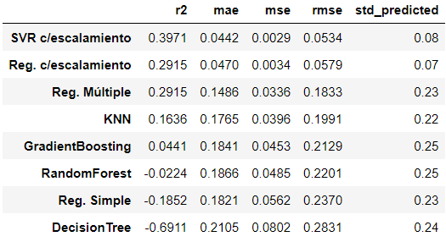
Error Zone
Support Vector Regressor had a pretty good MSE performance and low standard deviation on error zone predictions. It also had the best result explaining variability among all models
Again, data scalement considerably improved error metrics on testing phase
We added standard deviation to evaluate predictions dispersion

Slide 7

Insights business
Number of reviews does not have a strong relation with beer's review overall.
However, beers with more than 550 reviews have a better shot for a highlighting review overall.
Descriptive features best rated by reviewers were Malty and Sweet.
Average beers are between 3.5 and 4.25 review overall score.
Outstanding beers are above 4.25 review overall score. "Bad" beers standed between 3 and 3.5, while awful beers were below 3 review overall score.

Slide 8
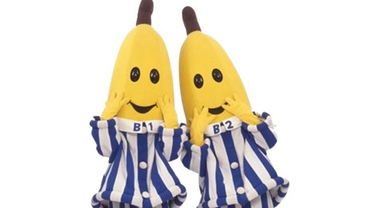
Insights methodological
Filtering dataset excluding most reviewed beers, as an outliers preprocessing, does not modify correlations between variables. In fact, it changes target feature distribution, so it is not recommended.
Grouping descriptive features on a single feature does not generate strong correlations, neither lineal nor no-lineal. This does not work also if we previously do feature selection.
That also applies for feature engineering by business criteria (grouping by dimensions like mouthfeel, taste and flavor & aroma).
Some pending for this dataset is completing the EDA with Beer Style feature analysis, evaluating its predictive weighted for target feature

Slide 9
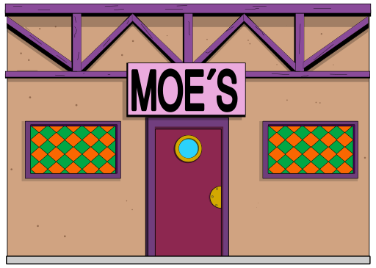
Final Considerations business impact
Review overall of products/services can be predicted disintegrating reviews in more specific dimensions.
This focus on consumption sensorial experience. General assesments always requires some abstraction level that is not the aim of reviews.
On beer experience specifically, it is more important palate than appearance or aroma.
With some limitations, our model could be useful for all business models based on reviews, from deliveries to on demand platforms enterprises, just for mentioning some famed examples.

Slide 10

THANKs
To professor Iair Moisés Linker San Juan and monitor Leyton Jean Pierre Castro Clavijo for all the advice

